Slide 1
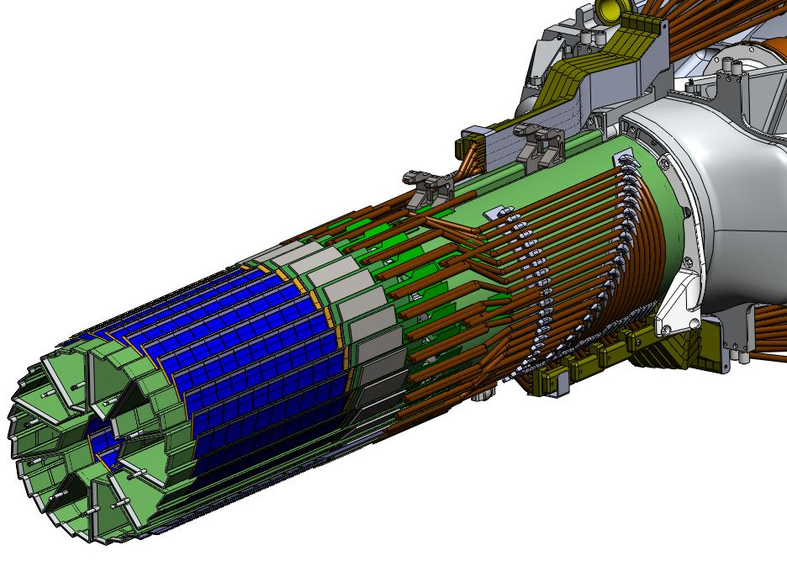
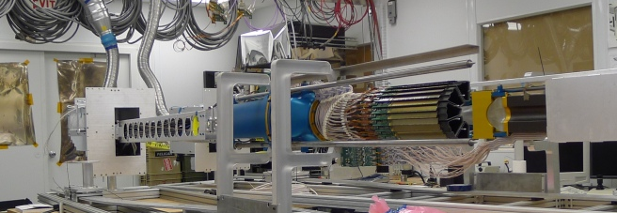
Heavy Flavor Tracker Pixel Detector
(HFT PXL)
Howard Wieman
LBNL
for HFT collaboration
First operational vertex detector based on Monolithic Active Pixel Sensors (MAPS) or also called CMOS Pixel Sensors (CPS)
CPS developed by PICSEL group of IPHC-Strasbourg
(Marc Winter et al.)

Slide 2
Outline
Introduction, description of HFT PXL and purpose
Requirements and fit to MAPS technology
Credit the IPHC group that developed the detector chip
Briefly cover how the chip works
What we can expect in detector chip development and how it can benefit STAR
Notes:
Normally I talk about the mechanics because that is where my personal effort has been over the last few years.
But, today I want to focus on the detector chip because that is what makes the HFT PXL detector unique and advances the detector beyond previous vertex detectors. Also the silicon is where we can expect additional advances in the near future. It is for this reason that extra design work has gone into the mechanics to make it hopefully possible to easily upgrade with newer silicon technology without a complete redesign and fabrication of the whole system.

Slide 3
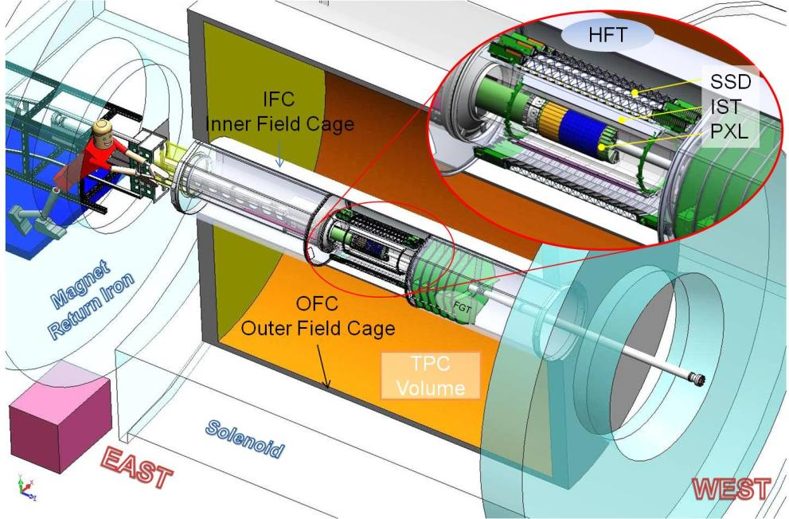
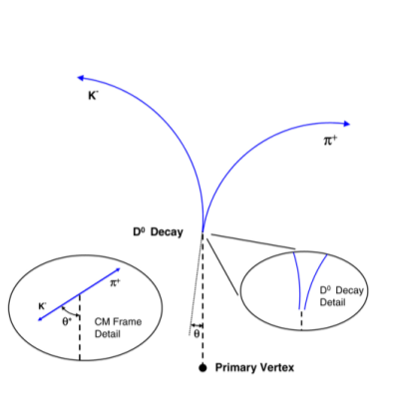
HFT PXL in STAR Inner Detector Upgrades
TPC – Time Projection Chamber
(main tracking detector in STAR)
HFT – Heavy Flavor Tracker
SSD – Silicon Strip Detector
  r = 22 cm
IST – Inner Silicon Tracker
  r = 14 cm
PXL – Pixel Detector
  r = 2.8, 8 cm
Direct topological reconstruction of Charm
We track inward from the TPC with graded resolution:
vertex
TPC
~1mm
SSD
~300µm
IST
~250µm
PXL
<30µm
Notes:
Ist is a silicon pad detector upgrade is several detectors, focus is on the pixle detectors. Other detectors connect tpc tracks with the pxl detector – don’t go into pointing

Slide 4
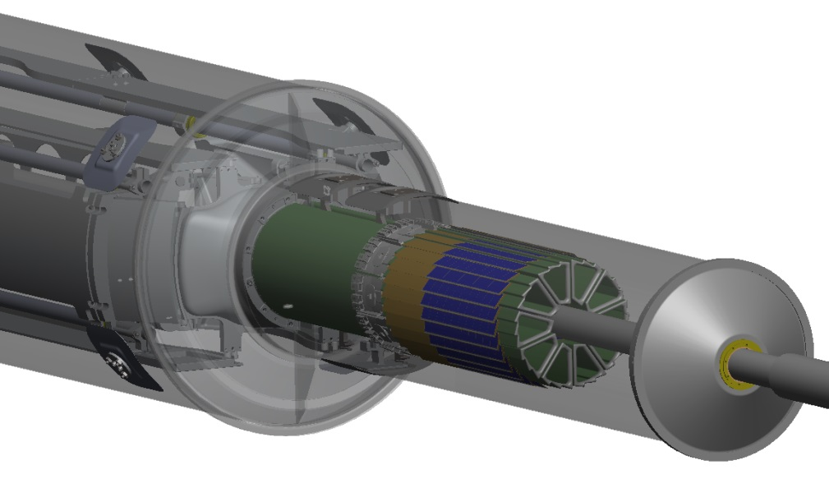
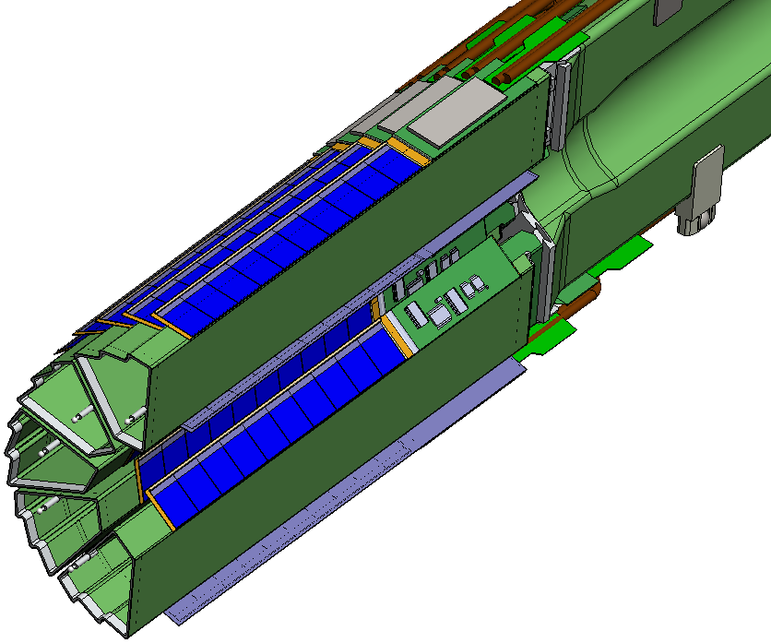
PXL Detector Design
Mechanical support with kinematic mounts (insertion side)
carbon fiber sector tubes (260 µm thick)
Insertion from one side
2 layers
5 sectors / half (10 sectors total)
4 ladders/sector
5 ladder weight 11.2 gm
Ladder with 10 MAPS sensors (approx. 2×2 cm each)
Aluminum conductor Ladder Flex Cable
20 cm

Slide 5
PXL Detector Design Characteristics
DCA Pointing resolution | (12* ⊕ 24 GeV/p⋅c) μm
Layers | Layer 1 at 2.8 cm radius Layer 2 at 8 cm radius
Pixel size | 20.7 μm X 20.7 μm
Hit resolution | 3.7 μm (6 μm geometric)
Position stability | 6 μm rms (20 μm envelope)
Radiation length first layer | X/X₀ = 0.39% (Al conductor cable)
Number of pixels | 356 M
Integration time (affects pileup) | 185.6 μs
Radiation environment | 20 to 90 kRad / year 2*10¹¹ to 10¹² 1MeV n eq/cm²
Rapid detector replacement | ~ 1 day
356 M pixels on ~0.16 m² of Silicon
* Simple geometric component, cluster centriod fitting gives factor of ~1.7 better.

Slide 6
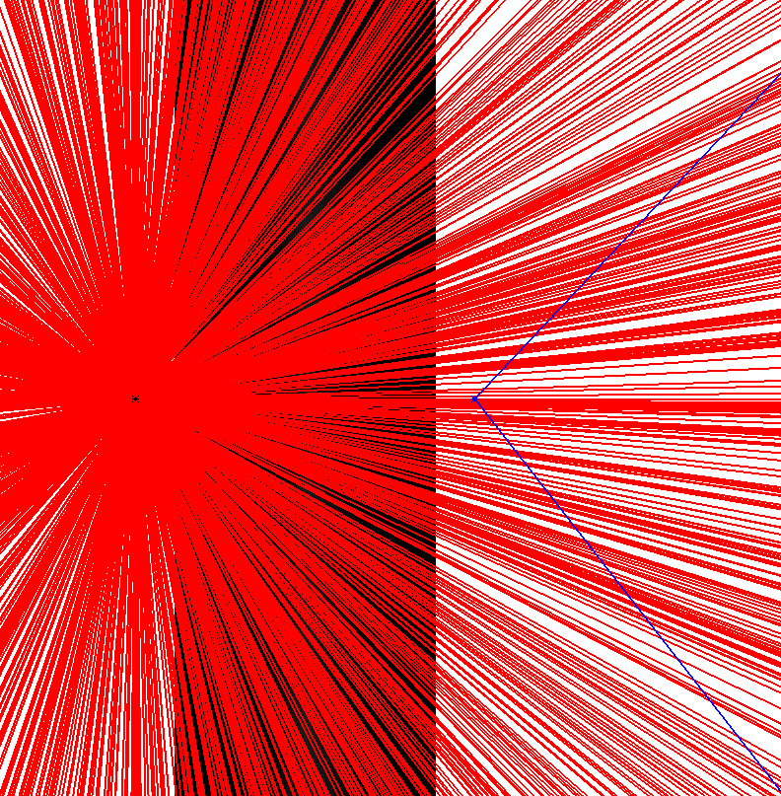
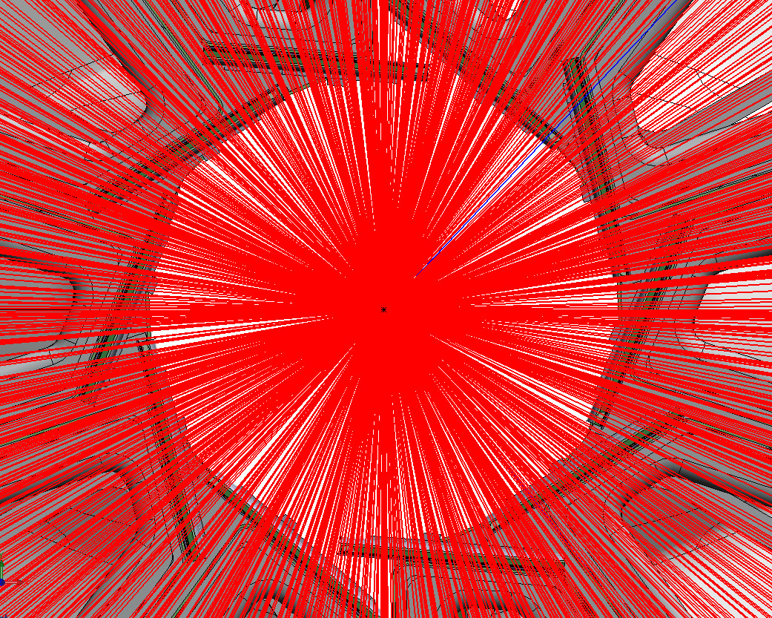

Au + Au 200 GeV central collision, η±1
dN/dη 650
The challenge
X160
X160
100 µm
human hair
for scale
D meson decay cτ 130 µm
Inner layer HFT PXL detector

Slide 7
Requirement:
The detector should resolve vertex locations as precisely as possible.
Which means:
Thin, reduced multiple coulomb scattering
Small high position resolution pixels
Stable, limited vibration and low position drift
Inner layer close to the beam
Additional requirements:
Fast, to reduce pileup which compromises hit to track association
Radiation hard
MAPS are particularly well suited to satisfying item 1 because they can be thinned to 50 µm, they don’t need an additional silicon readout layer, and they are relatively low power and can therefore be cooled with air, avoiding more massive cooling systems.
MAPS satisfy item 2, they have smaller pixels than alternative technologies. This is more important than one might think and will be addressed in more detail in the next slide.
MAPS are limited in satisfying items 5 and 6, pileup and radiation hardness. This is where one can expect improvements in the future. Some of these expectations will be covered.

Slide 8
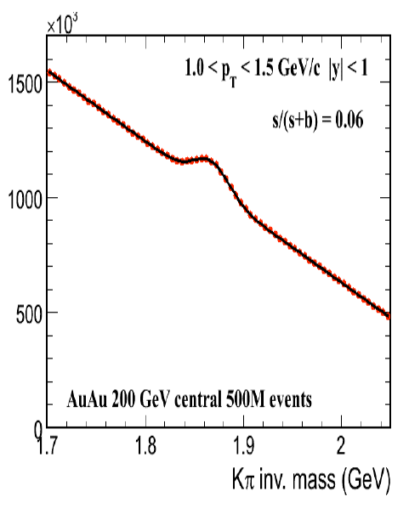
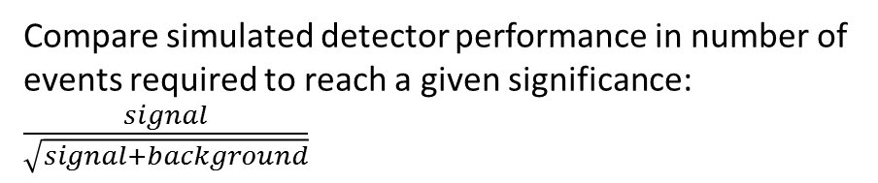
The advantage of improved spatial resolution and reduced radiation length
Compare simulated detector performance in number of events required to reach a given significance: $\frac{signal}{\sqrt{signal+background}}$
Simulation results
 | Pixel size | radiation length | 0.5 GeV D₀ relative number of events | 1.5 GeV D₀ relative number of events
hybrid | 50 μm x 450 μm | 1.4% | 36 | 200
MAPS | 27 μm x 27 μm | 0.6% | 1 | 1
S
+
B
parameters used in the simulation, but
actual HFT PXL parameters are smaller

Slide 9
  Marc Winter’s IPHC MAPS Team in Strasbourg:
  Design, testing, integration
    2000: 3 FTE ➔ 2014: ~25-30 FTE
    ~ 20 Ph.D students involved in the development
Designed and developed the STAR PXL detector chip
Worked closely with LBNL with significant interaction with Leo Greiner and his team adjusting design to provide diagnostic and testing features.
Arranged for Michal Szelezniak to move to LBNL help with integration of MAPS in our project
Their graduating students have moved on and done well at other detector design centers:
  Grzegorz Deptuch, group leader at Fermi Lab
  Renato Turchetta, group leader at Rutherford Appleton Lab
from CPIX14 15-17 September 2014, University of Bonn, IPHC christine.hu@in2p3.fr
  Institut Pluridisciplinaire Hubert Curien (IPHC)

Slide 10
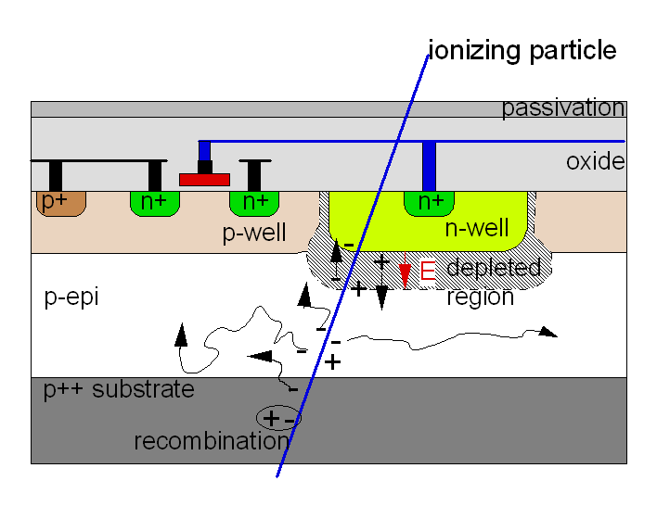
charge reflection where p doping changes generating an E field
Some features of the CPS in HFT PXL
basic sensing diode in traditional CPS
Ion ionizing radiation generates electron hole pairs
Electrons in the depleted region drift (rapid transfer to the n well)
Electrons in the non depleted p-epi feel no field and randomly diffuse (a slow process) before the reach a depleted region and are captured
On the detection time scale the diode is electrically isolated so that the voltage on the diode is a step function with ∆V = ∆Q/C. This voltage change is recorded through Correlated Double Sampling (CDS)

Slide 11
Some features of the CPS in HFT PXL
The PXL chip has an amplifier and CDS built into each PXL. This allows a single discriminator be used to successively to record hits for multiple pixels.
Some added comments while this picture is up:
Over the development time of the PXL detector, improvements in the CMOS available to IPHC lead to important improvements. The available p-epi layer went from 10 Ω cm to 400 Ω cm, that is the p-epi is less heavily doped and consequently the depletion region thickens. This improves the signal to noise because C is smaller resulting in better signal to noise (remember ∆V = ∆Q/C). This and the reduced charge collection time improves radiation hardness. Reducing the charge collection time means less probability for electrons to be trapped on the radiation induced defects. Slow electrons in the diffusion region are more likely to be trapped than the fast electrons in the depleted drift region.

Slide 12
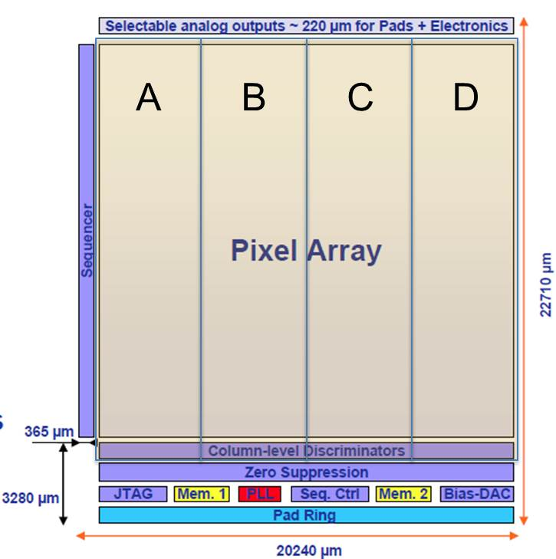
Rolling shutter readout
A row is selected, and each pixel in the row is connected to it’s column
Once the column line has settled the discriminator at the end of the column identifies whether the pixel contained a hit and then the row counter advances to the next row to repeat
A hit is recorded for any particle that passes between interrogations, so cycling faster reduces pileup
discriminator at the end of each column
readout time of STAR PXL chip: 186 μs
Rows: 928
Columns: 960
With this scheme the frame time or readout frequency is limited by the power vs time trade off of charging the long column lines connecting the pixel to the discriminator. It is for this reason that many groups are working on methods to include the discriminator within the pixel. Having a discriminator in each pixel can lead to a significant reduction in the readout time, more on this later.

Slide 13
The current version of the HFT PXL detector is cutting edge and will allow for the first time topological reconstruction of Ds in a heavy ion environment.
But, there is room for improvement. A much shorter read out time would be big for the following two reasons.
Reduced pileup to improve hit to track association and allow operation at higher luminosities
Allow use of PXL data in the trigger definition
Next, what we can expect from improved technology

Slide 14
One example, a faster readout based on the token approach.
Readout does not require an external scan of all the pixels
discr
latch
latch holds for
2-3 µs (trigger latency time)
If a pixel is hit the latch remains on for a few µs
If a trigger arrives during that time then the latch is held active
The token stops at the next active pixel and the pixel connects to the address generators. Since this is a logic connection settling time is short compared to an analogue connection. Plus only hit pixels get connected to the perimeter. This is the big time saver over the current HFT PXL chip.
The token is released and ripples through to next active pixel. The pixel to pixel ripple through is very fast since it is local logic not requiring a clock.
shaper
pre
amp
trigger
token
initiator
token cell
Token cells have combinatorial logic, zippers to the next set latch in the time that the previous latched pixel address is generated and sent off chip.
Each pixel has a pre-amp, shaper, discriminator latch and token cell. The discriminator is active full time.
row
address generator
column
address generator
tokens, a concept used in hybrid technology, FPIX, 1999, Fermi Lab

Slide 15
The main point of the last slide was to show that with a discriminator on each pixel there are ways to read out a chip without interrogating each pixel from the perimeter of the chip and that greatly speeds up the readout of the chip.
Walter Snoeys and Luciano at CERN are developing the ALPIDE chip which has an amplifier and discriminator on each pixel and also uses asynchronous (combinatorial) readout logic. It accomplishes the same thing as the token approach, namely only hit pixels get clocked out to the periphery.
See:
Marc Winter’s talk: “CMOS Pixel Sensors Developed for the ALICE-ITS Upgrade” Workshop on CMOS Active Pixel Sensors for Particle Tracking (CPIX14) 15-17 September 2014, University of Bonn
http://indico.cern.ch/event/309449/session/20/contribution/9/material/slides/
also:
The ALICE Collaboration, J. Phys. G: Nucl. Part. Phys. 41 (2014) 087002, 2.5.4 ALPIDE, p. 22

Slide 16
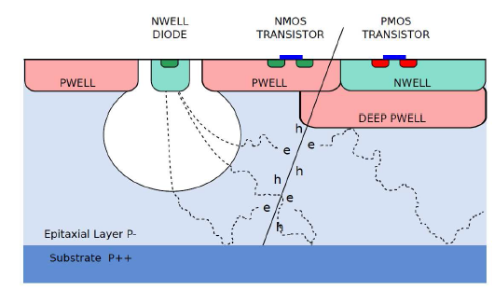
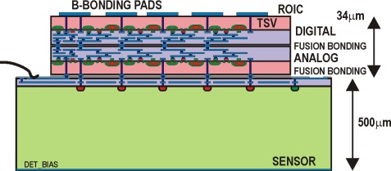
Requirements for an on pixel discriminator
Need more signal for operation with a simple on pixel discriminator. This is required to overcome variations in discriminator thresholds.
∗
Two options being studied
Deep p-well so that both p channel and n channel FETs can be placed in the pixel. Better amplifies that can provide a larger signal require both p and n channel FETs. With traditional CMOS technology only n channel FETs can be used.
3D technology where the amplifiers and other electronics are in one layer and the sensor silicon is a separate layer directly bonded and coupled to the electronics layer. This is in the same spirit as earlier hybrid pixel designs, but the coupling technology provides higher pixel densities than can be achieved with traditional bump bonding. By having a separate sensor silicon one can use a thicker high resistive silicon and full depletion to produce a larger signal. Also, both NMOS and PMOS is available for the Read Out Integrated Circuit (ROIC).
#
∗ Fig. from Marc Winter’s talk: “CMOS Pixel Sensors Developed for the ALICE-ITS Upgrade” Workshop on CMOS Active Pixel Sensors for Particle Tracking (CPIX14) 15-17 September 2014, University of Bonn
# Fig. from Grzegorz Deptuch’s talk: “MAPS are for amateurs, professionals do 3D” Workshop on CMOS Active Pixel Sensors for Particle Tracking (CPIX14) 15-17 September 2014, University of Bonn

Slide 17
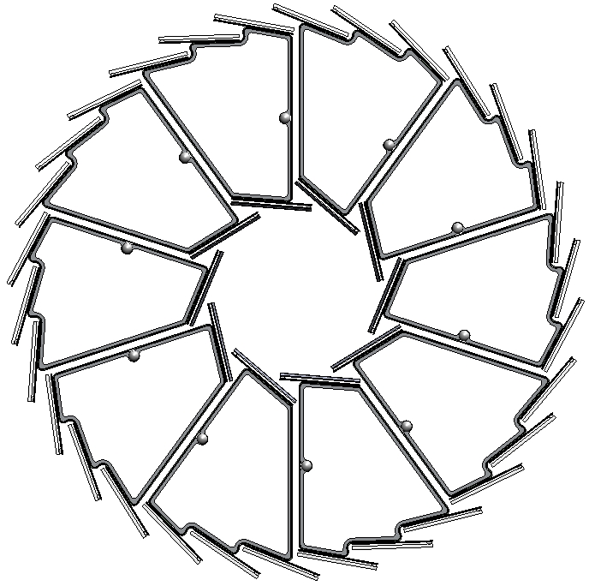
In conclusion the HFT PXL detector installed in STAR is providing excellent pointing resolution
Cosmic ray result
Excellent half to half pointing, sub 30 μm
But after half to half alignment which was required to correct poor reproducibility of kinematic mount seating
X
X
X
X
X
Xs shows how hits are selected for projective distance of closest approach comparison
X
AND

Slide 18
We are well positioned with our quick change mechanics to take advantage of expected new pixel technologies that will both allow operation at increased luminosities and use of pixel information in trigger decisions.

Slide 19
backup

Slide 20
Deptuch chip: 400 mW or 100 mW/cm²
ALPIDE: 50 nW/pixel or 48 mW for 980² pixels

Slide 21
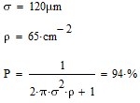
Reduce pileup and improve hit to track association
Roughly where we are now with the HFT PXL at current luminosity
combined position uncertainty between a track and a hit on the inner layer
hit density on the inner layer, scales with luminosity and integration time
probability of correctly associating the hit with the track
Pileup hit density will be increasing with luminosity further compromising the ability to correctly associate hits with tracks.
The solution is reduced readout time/integration time for accumulating pileup hits.

